Slide 1
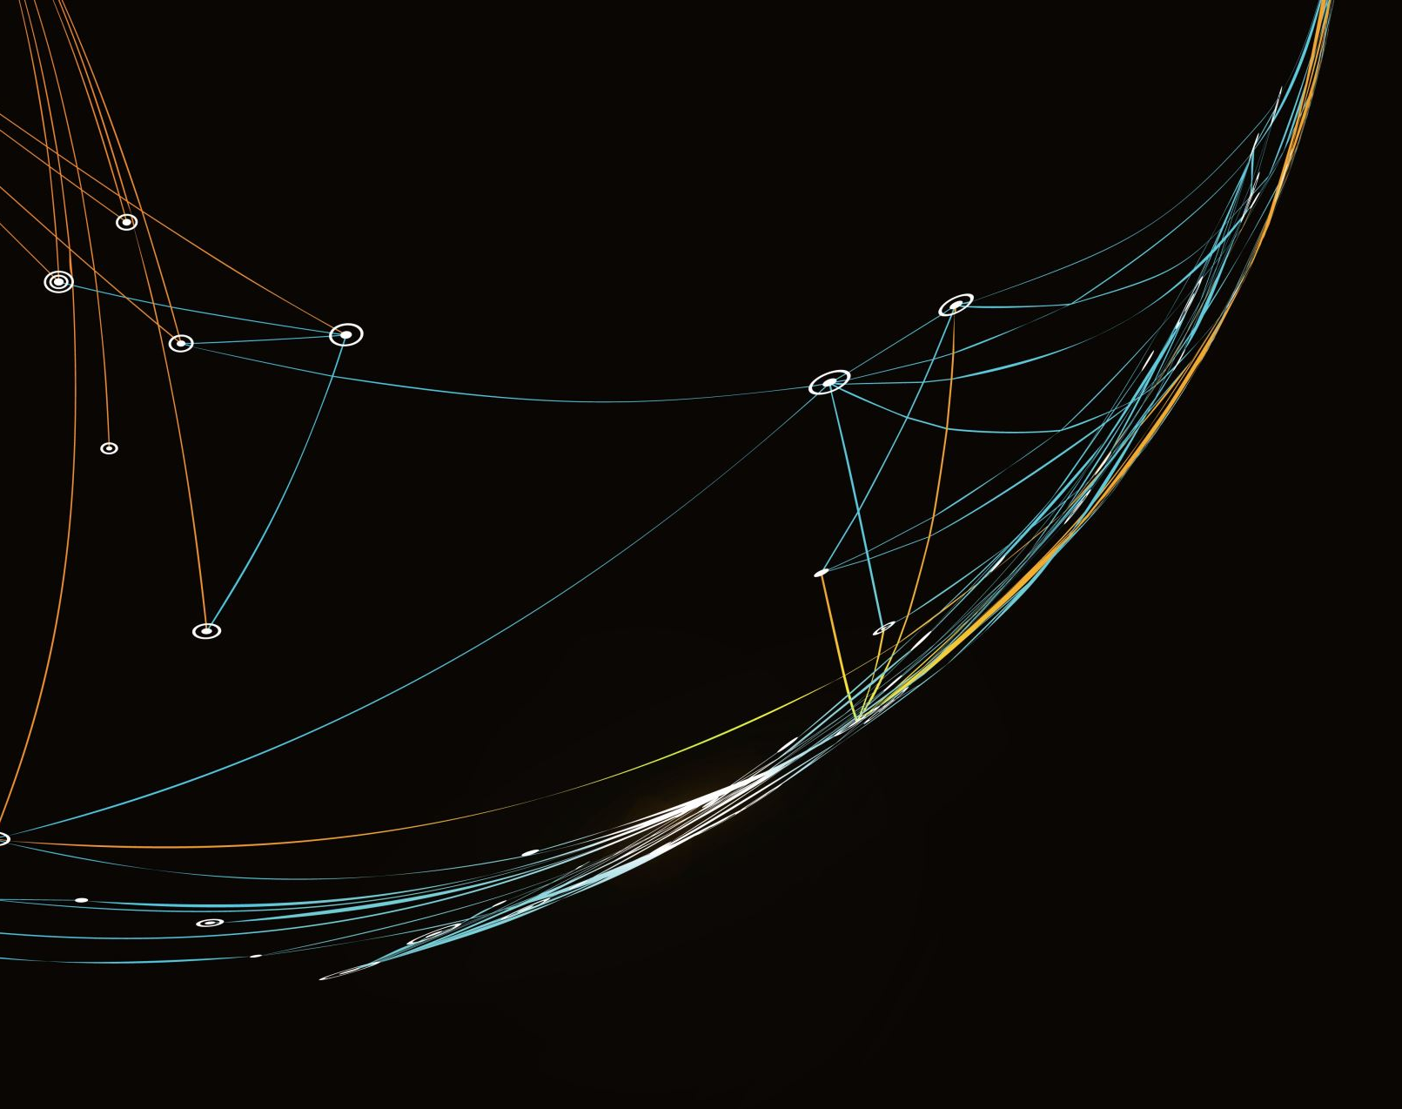
Predicting GPU performance based on specification
MLDP Wei Ming Jun

Slide 2
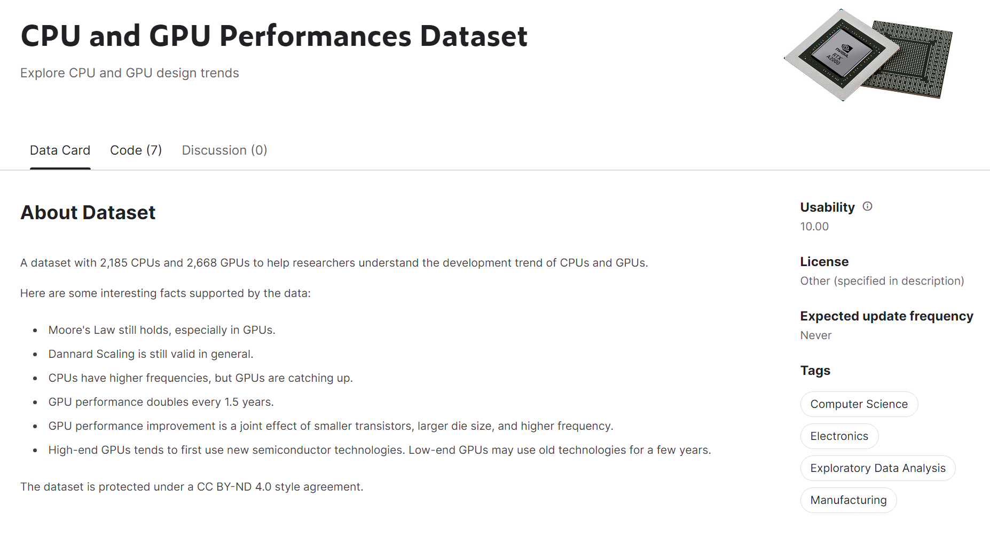
About the project & dataset
GPUs have been rapidly advancing and prices have gone up
Dataset taken from Kaggle and contains GPU’s specifications and performance metrics
Prediction based on GPU specifications to give insight to users that want to know more about the product
Notes:
Between 2020 and 2022, the demand for anime content has surged to be more than double of what it used to, making it the fastest-growing content genre during the pandemic. This surge in viewership has created a gap for viewers searching for new anime suited to their tastes. Current methods for finding new anime are tedious, as users must manually search through all the new releases each season and read about them to determine if they are interested. With over 25 new anime released every season, totaling about 100 new anime each year, it can be difficult for viewers to navigate through all the new and existing anime to find a series they will enjoy. This also makes it challenging for smaller studios producing niche anime to reach a larger audience compared to larger studios with more marketing power. Popular animes become even more popular while niche animes barely get any traction. This could be detrimental to competition in this space as it may demotivate smaller studios from producing their own anime as they may not see the point of creating something that people may not even get to see. Thus, there is a need for a platform that can provide personalized recommendations based on AI, communities to discuss new anime, and spotlight for smaller and less well-known studios. This platform would be based in the cloud and deliver tailored experiences to end-users while bringing the community together on their common ground - their love for anime.

Slide 3
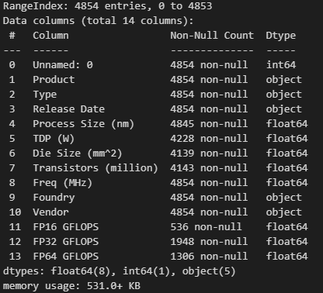
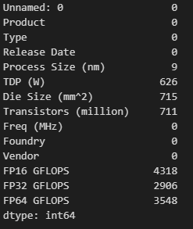
Pre-processing of data
Looking through dataset and finding missing values
1
Dropping unneeded columns
2
Deleting rows where column Type is CPU
3
Transforming Date into relative years for better model building
4
Producing correlation analysis to determine trends in the dataset
5
Creating new columns based on existing columns in the dataset
6
Notes:
My proposed solution is to create an all-in-one website for anime fans that provides personalized recommendations of anime using Amazon Personalize. The website will also have a community forum for users to discuss the anime they are watching, and this forum will use Amazon Translate to automatically translate posts into the user’s native language. This will help break down language barriers and make the forum accessible to anime fans worldwide. The website will use SQL databases to store data, and these databases will communicate with each other to feed data to Amazon Personalize. Amazon API Gateway will be used to connect the website to third-party databases to collect information and update the anime database on a regular basis. Since this is a website, it will be accessible from anywhere in the world at any time.

Slide 4
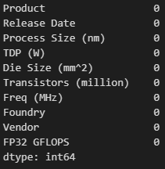
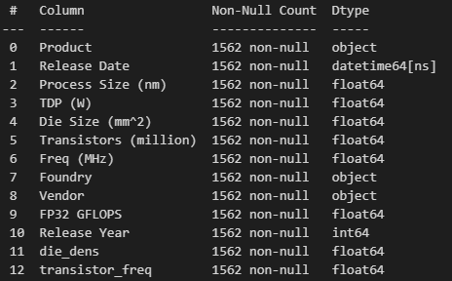
Pre-processing: Data cleaning
Columns dropped
Unnamed :0
Type
FP16 GFLOPS
FP64 GFLOPS
Dropped rows where
FP32 is missing
TDP/Die Size/Transistors/Freq/Process Size is missing
Release date is missing
Notes:
My proposed solution is to create an all-in-one website for anime fans that provides personalized recommendations of anime using Amazon Personalize. The website will also have a community forum for users to discuss the anime they are watching, and this forum will use Amazon Translate to automatically translate posts into the user’s native language. This will help break down language barriers and make the forum accessible to anime fans worldwide. The website will use SQL databases to store data, and these databases will communicate with each other to feed data to Amazon Personalize. Amazon API Gateway will be used to connect the website to third-party databases to collect information and update the anime database on a regular basis. Since this is a website, it will be accessible from anywhere in the world at any time.

Slide 5
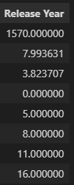
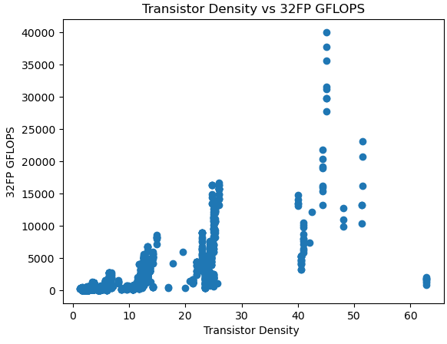
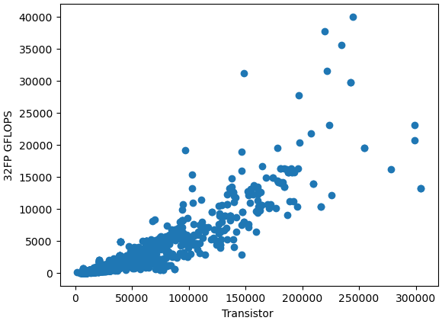
Pre-processing: Data engineering
Release Year
- Derived from Release date
- Compresses the year to a smaller number
- Reduces the model bias
Die density
- Calculated by transistors/die area
- Emphasizes the relationship the two columns have on the target column
Transistor frequency
- Calculated by
- ((transistors)^0.5)(Freq)
- Better at capturing the nonlinear nature of the dataset
Notes:
Serverless deployment
Serverless deployment is chosen as it have many benefits like
No server management
There’s the reduced work of planning for provisioning, configuring and management of servers which reduces the workload significantly and allows me to focus my work on the actual website and how it works instead of the hardware details
Flexible scaling
This allows the website to scale up and down dynamically based on the incoming traffic at different times of the year, day and hour. All these is done without any kind of configuration, downtime and lag in the website. This ensures that my website is rather resistant to traffic influx unlike a server deployment where traffic influx have to be taken into consideration when configuring the server.

Slide 6
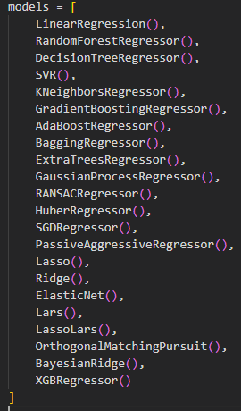
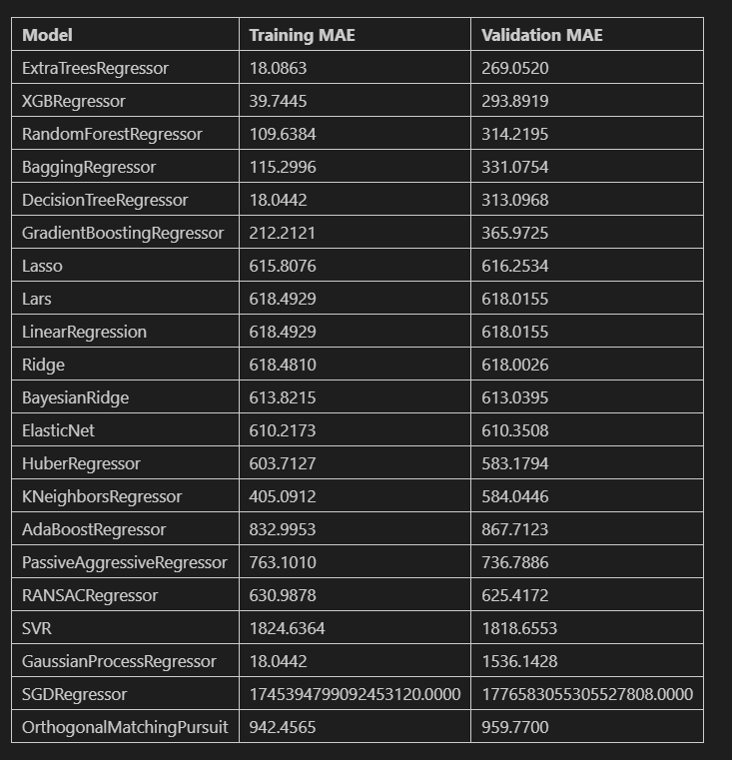
Modelling: finding models
22 models were used to find the best one based on performance.
Techniques were used to prevent overfitting and ensure replicability.
The best model was chosen based on its balance between accuracy and overfitting.

Slide 7
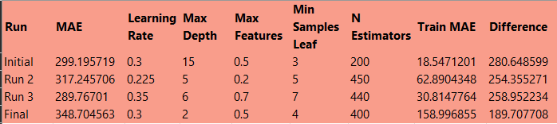
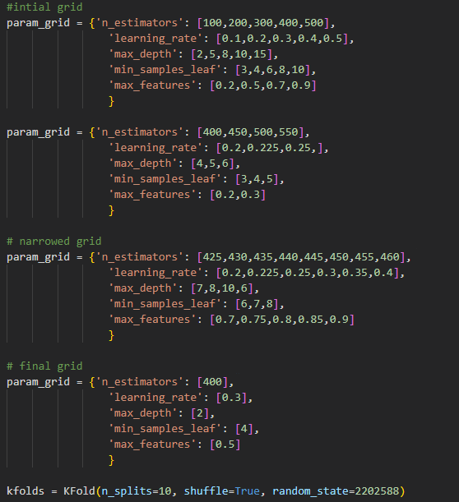
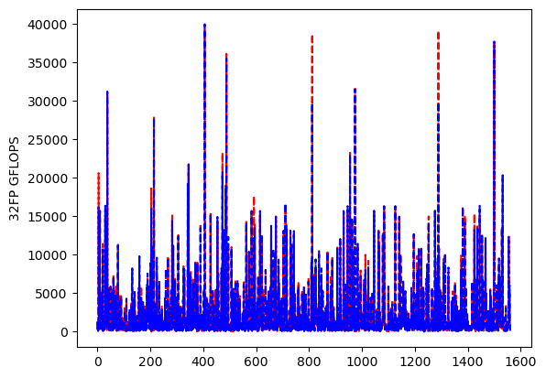
Modelling: Tuning models
The goal was to reduce overfitting and increase accuracy by minimizing the difference between testing and training MAE.
Parameters were narrowed down based on observed trends, with the final parameters chosen based on their balance between accuracy and overfitting.
The final parameters were validated with a graph.
Notes:
DynamoDb
This is a fully managed NoSQL database which is flexible as the columns are not fixed
This is perfect for storing information like Anime where the information can change, and additional information may be added later
DynamoDb is also really efficient and fast providing single digit millisecond latency no matter the scale which is important for a website that consists of tens of thousands of anime listings
Amazon Kendra
This is a search service that is powered by natural language processing to deliver highly accurate results.
The results can also be fine-tuned based on context which is great for my website as often people might want to search for an anime that they have forgotten the name to, so they start describing an event that took place in the anime.
Amazon Rekognition
This is a service that can recognise objects, faces and text from photos and videos
This is useful for my website as images that are added can be ran through Rekognition to identify characters from different anime and group them accordingly

Slide 8
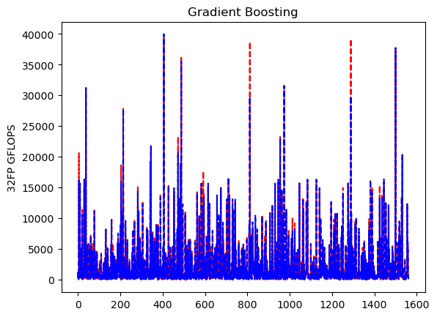

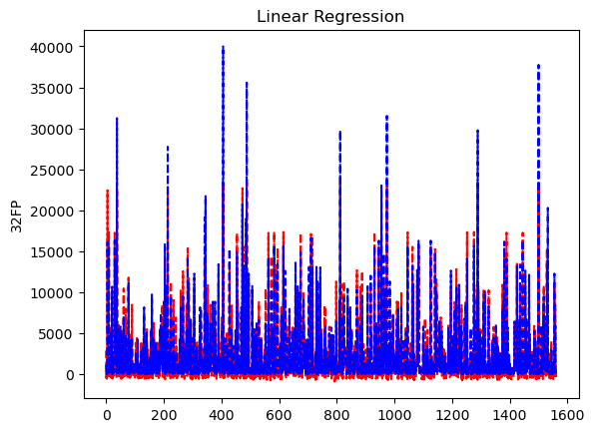
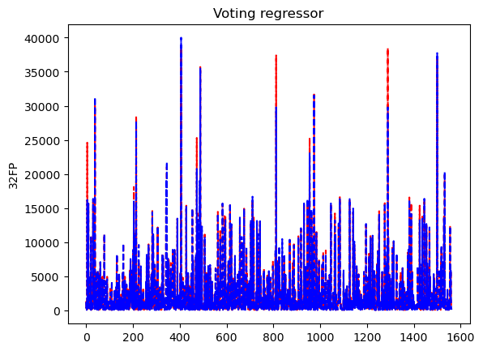
Modelling: Evaluating
Different models were compared for accuracy using a cross plot and mean absolute error.
The difference between testing and training mean absolute error was used to measure overfitting.
Kfolds were used together with a set random seed
Minimized randomness in the results

Slide 9
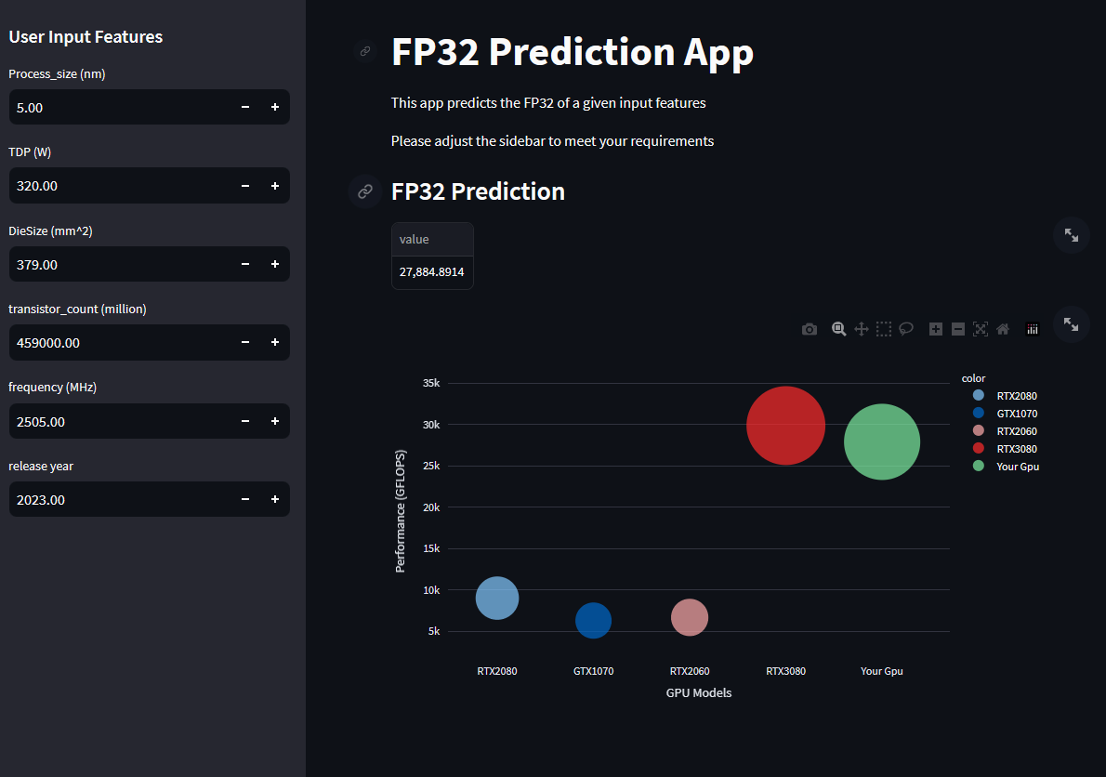
Deployment: Deciding on model
The chosen model provides needs to be accurate and reliable predictions for unseen data
Instill confidence in users every time its used
The gradient boosting regressor is chosen as the best model overall
Relatively low mean absolute error
A small difference between testing and training mean absolute error

Slide 10
Thank You
QnA

